Slide 1
AT CATEGORY PREFERENCE MODELS
Customer Data Science
June 2016

Slide 2
Background
Web and Mobile browsing is more effective when it is personalized
Personalized Web pages providing tailored user experience help improve:
Customer satisfaction
Higher engagement
Digital sales conversion
Marketing results
Improved website metrics
Category preference model ruminates right set of categories as per individual customer’s browsing and shopping history
Category Preference Model determines order of categories for individual customers
Gap Inc Confidential – Do Not Distribute or Copy Without Authorization

Slide 3
Modeling Details
Scope: AT US
Algorithm: LambdaMart
Data: Browse and Transaction Data
Platforms & Packages: Hive, R, Java
Training
Validation
Purchase Data
1/1/2015- 12/31/2015
Purchase Data
1/1/2016- 03/31/2016
Browse Data
10/1/2015- 12/31/2015
Product to Category Mapping
Data Preparation
Experimenting with various ranking algorithms
Training Dataset : 100,000 master-keys, 3332868 records
Testing Dataset : 939392 master-keys, 3132082 records
Testing and Validation
Training the final model
Finalizing Algorithm using Cross Validation
Gap Inc Confidential – Do Not Distribute or Copy Without Authorization

Slide 4
Product Categories, Predictors and Algorithms Tested
Browsed Items in last 1 month
Items abandoned in last 1 month
Purchases in last 1 month
Time since last purchase in last 12 months
Time since last basket abandonment in last 3 months
Time since last browse in last 3 months
Product Categories
Last 1 Month
Activities
Recency
WOMENS PANTS
WOMENS OUTERWEAR
WOMENS TOPS
WOMENS DRESSES
WOMENS SHORTS
WOMENS SUPPORT TOPS
WOMENS CAPRIS
WOMENS SWIM TANKINI
WOMENS SKORTS
WOMENS SWIM BIKINI
WOMENS SWIM BOTTOMS
WOMENS SKIRTS
WOMENS BRAS
WOMENS SWIM ONE PIECE
WOMENS FOOTWEAR
WOMENS ACCESSORY
WOMENS SWEATERS
WOMENS SWIM RASHGUARDS
WOMENS INTIMATES
Last 3 Months
Activities
Historical Activities
Browsed Items in last 3 months
Basket Abandonments in last 3 months
Purchased Items in last 12 months
Purchased Items during same period last year
The following algorithms were experimented with for training the model
LambdaMart
AdaRank
ListNet
Coordinate Ascent
RankNet
Gradient Boosting
Random Forest with Gradient Boosting
Random Forest with LambdaMart
LambdaMart performed the best in terms of training, cross-validation and testing NDGC.
Gap Inc Confidential – Do Not Distribute or Copy Without Authorization

Slide 5
Relative Influence of the Predictors and Model Performance on Exact Matches
To analyze the performance of the models, we have compared the model with the following rule based algorithms.
Rule 1: Customers are going to purchase from the same categories in the same order of preference in the next 3 months as they did in the last 12 months.
Rule 2: Customers are going to purchase from the same categories in the same order of preference in the next 3 months that they browsed in the last 3 months.
Rule 3: Customers are going to purchase from the same categories in the same order of preference in the next 3 months as they did in the same period last year.
Using Rule 1, we could assign category preferences for 1.64 M customers.
Out of them, 326K customers made a purchase in the next 3 months. The model predicts the most preferred category correctly for 144K out of those 326K customers whereas Rule 1 predicts it correctly only for 137K customers. Based on exact rank matches, the model performs consistently better than Rule 1 for all of Top 1 to Top 19 categories by 2.5% to 3%.
Gap Inc Confidential – Do Not Distribute or Copy Without Authorization

Slide 6
Model Performance Continued – Exact Matches
Rule 2: Customers are going to purchase from the same categories in the same order of preference in the next 3 months that they browsed in the last 3 months.
Using Rule 2, we could assign category preferences for 876K customers.
Out of them, 203K customers made a purchase in the next 3 months. The model predicts the most preferred category correctly for 81K out of those 203K customers whereas Rule 2 predicts it correctly only for 75K customers. Based on exact rank matches, the model performs consistently better than Rule 2 for all of Top 1 to Top 19 categories by 3%.
Rule 3: Customers are going to purchase from the same categories in the same order of preference in the next 3 months as they did in the same period last year.
Using Rule 3, we could assign category preferences for 602K customers.
Out of them, 168K customers made a purchase in the next 3 months. The model predicts the most preferred category correctly for 68K out of those 168K customers whereas Rule 3 predicts it correctly only for 66K customers. Based on exact rank matches, the model performs consistently better than Rule 3 for all of Top 1 to Top 19 categories by 1.5% to 2%.
Gap Inc Confidential – Do Not Distribute or Copy Without Authorization

Slide 7
Model Performance Continued – Normalized Discounted Cumulative Gain / NDCG
Normalized discounted cumulative gain or NDCG measures the performance of a recommendation system based on the graded relevance of the recommended entities. It varies from 0 to 1 with 1 representing the ideal or perfect ranking of the entities. This metric is commonly used in information retrieval and to evaluate the performance of web search engines.
NDCG is a key metric to help determine the performance of a ranking algorithm and assigns more weightage to top preferences and less weightage to the entities with lower preference. Hence a wrong rank assignment to a top ranking entity is penalized more than a wrong assignment to a low ranking one.
The graphs illustrate that the model outperforms all the three Rule based Algorithms, as laid out in the preceding slides, by a magnitude of 3% to 5%.
Gap Inc Confidential – Do Not Distribute or Copy Without Authorization

Slide 8
Model Performance Continued – Rank Order Matches
Rank Order Match is a more relaxed and in a sense an effective evaluation criteria for a ranking algorithm. An entity within a list will be deemed as correctly rank ordered if the predicted rank follows the same order as the observed rank not necessarily in magnitude but definitely in direction.
As seen from that graphs, the model performs better than all the three Rule based Algorithms, as laid out in the preceding slides, by 2% to 3%.
Gap Inc Confidential – Do Not Distribute or Copy Without Authorization

Slide 9
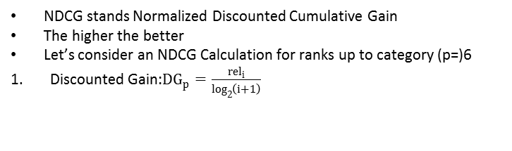
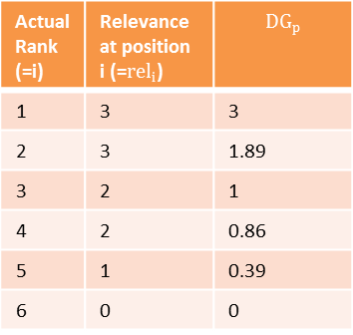
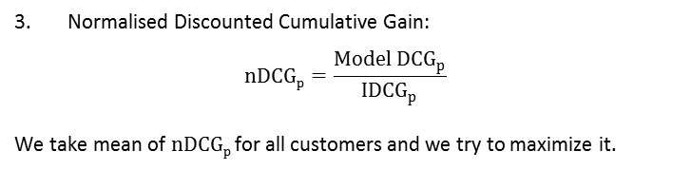
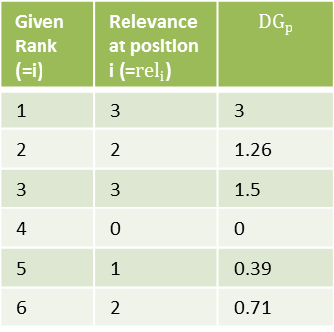
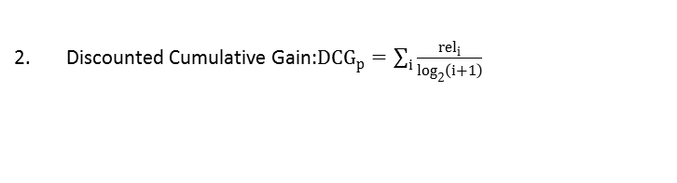



Illustrations – Normalized Discounted Cumulative Gain / NDCG
 | Customers who have purchased in last 12 months |  | Customers who have browsed in last 3 months |  | Customers who have purchased in first 3 months
Ranks up to | Model | Baseline | Model | Baseline | Model | Baseline
1 | 56.4% | 53.8% | 54.2% | 50.5% | 55.1% | 53.0%
2 | 68.7% | 65.8% | 64.8% | 60.9% | 65.2% | 62.9%
3 | 75.0% | 72.0% | 70.9% | 66.7% | 71.1% | 69.0%
5 | 80.9% | 77.4% | 77.4% | 72.2% | 77.4% | 75.3%
10 | 84.2% | 80.0% | 81.6% | 75.3% | 81.8% | 79.1%
19 | 84.4% | 80.1% | 82.1% | 75.5% | 82.2% | 79.4%
NDCG stands Normalized Discounted Cumulative Gain
The higher the better
Let’s consider an NDCG Calculation for ranks up to category (p=)6
Discounted Gain:${DG}_{p}=\frac{{rel}_{i}}{\log_{2}\left(i+1\right)}$
Given Rank (=i) | Relevance at position i (=${rel}_{i}$) | $${DG}_{p}$$
1 | 3 | 3
2 | 2 | 1.26
3 | 3 | 1.5
4 | 0 | 0
5 | 1 | 0.39
6 | 2 | 0.71
Actual Rank (=i) | Relevance at position i (=${rel}_{i}$) | $${DG}_{p}$$
1 | 3 | 3
2 | 3 | 1.89
3 | 2 | 1
4 | 2 | 0.86
5 | 1 | 0.39
6 | 0 | 0
Model DGs
Ideal DGs
Different metrics from the same model because of selecting (and evaluating) only that subset of customers which exactly match the corresponding business criterion
Discounted Cumulative Gain:${DCG}_{p}=\sum_{i}{\frac{{rel}_{i}}{\log_{2}\left(i+1\right)}}$
Model DCG
$${DCG}_{p}$$
6.86
Ideal DCG
$$I{DCG}_{p}$$
7.14
Normalised Discounted Cumulative Gain:
$$nDCGp=\frac{Model {DCG}_{p}}{{IDCG}_{p}}$$
We take mean of $nDCGp$for all customers and we try to maximize it.
$${nDCG}_{p}$$
0.96
Gap Inc Confidential – Do Not Distribute or Copy Without Authorization

Slide 10
Validations: Exact Match
 | Customers who have purchased in last 12 months |  | Customers who have browsed in last 3 months |  | Customers who have purchased in first 3 months
Ranks up to | Model | Baseline | Model | Baseline | Model | Baseline
1 | 44.1% | 42.1% | 39.8% | 36.9% | 40.8% | 39.7%
2 | 32.5% | 30.4% | 26.6% | 23.6% | 26.3% | 24.6%
3 | 30.7% | 28.6% | 24.4% | 21.3% | 23.8% | 22.0%
5 | 30.5% | 28.3% | 24.0% | 21.0% | 23.5% | 21.6%
10 | 30.5% | 28.3% | 24.0% | 21.0% | 23.5% | 21.6%
19 | 30.5% | 28.3% | 24.0% | 21.0% | 23.5% | 21.6%
Example with Ranks up to 4
Ideal Rank | Given Rank
2 | 2
4 | 4
3 | 3
1 | 1
Ideal Rank | Given Rank
2 | 1
4 | 4
3 | 2
1 | 3
Counted as a Match
Counted as a No-Match
Different metrics from the same model because of selecting (and evaluating) only that subset of customers which exactly match the corresponding business criterion
$Exact Match \%=Number of Exact Matches /Number of Customers$ $×$100
Gap Inc Confidential – Do Not Distribute or Copy Without Authorization

Slide 11
Validations: Rank Order
 | Customers who have purchased in last 12 months |  | Customers who have browsed in last 3 months |  | Customers who have purchased in first 3 months
Ranks up to | Model | Baseline | Model | Baseline | Model | Baseline
1 | 44.1% | 42.1% | 39.8% | 36.9% | 40.8% | 39.6%
2 | 46.9% | 43.8% | 42.8% | 38.5% | 43.0% | 40.7%
3 | 47.8% | 44.5% | 44.0% | 39.2% | 44.1% | 41.4%
5 | 48.4% | 44.9% | 44.7% | 39.7% | 44.8% | 42.0%
10 | 48.6% | 45.1% | 45.0% | 39.9% | 45.1% | 42.2%
19 | 48.6% | 45.1% | 45.0% | 39.9% | 45.1% | 42.2%
Example with Ranks up to 4
Ideal Rank | Given Rank | Rank Order for Given Rank
2 | 7 | 2
4 | 12 | 4
3 | 9 | 3
1 | 6 | 1
Ideal Rank | Given Rank | Rank Order for “Given Rank”
2 | 1 | 1
4 | 6 | 4
3 | 4 | 2
1 | 5 | 3
Counted as a Match
Counted as a No-Match
Different metrics from the same model because of selecting (and evaluating) only that subset of customers which exactly match the corresponding business criterion
$Exact Match \%=Number of Exact Matches /Number of Customers$ $×$100
Gap Inc Confidential – Do Not Distribute or Copy Without Authorization

Slide 12
Sample Output
MASTER KEY | CATEGORY | SCORE | RANK
0-2014070883916-17380 | WOMENS PANTS | -0.25572 | 3
0-2014070883916-17380 | WOMENS TOPS | 0.141682 | 2
0-2014070883916-17380 | WOMENS OUTERWEAR | 0.161093 | 1
0-2014070883917-34200 | WOMENS TOPS | 0.560534 | 1
0-2014070883917-34200 | WOMENS SKORTS | 0.217653 | 2
Category Preference Ranks for individual customers
Gap Inc Confidential – Do Not Distribute or Copy Without Authorization

Slide 13

Appendix

Slide 14
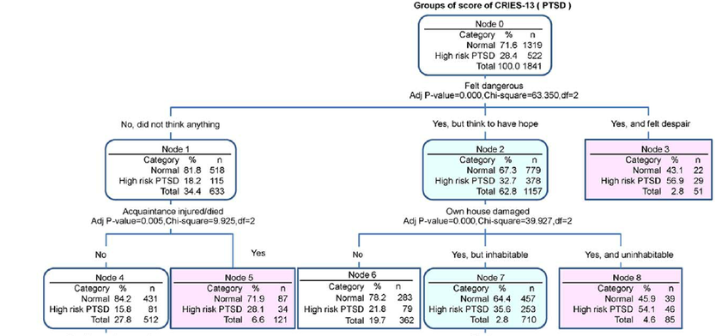
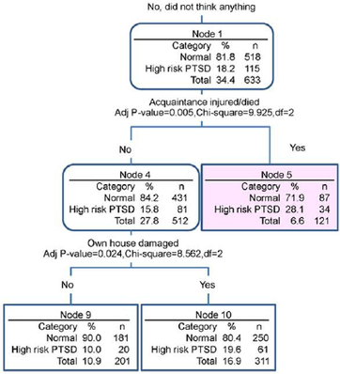
LambdaMart Algorithm Explained
We make the basemodel for {x_{i,}y_{i}} by using least square regression tree which gives scores s_{i}
Utility function C is ∑_{{i,j}}|∆z_{ij}|log(1+exp^{-σ(s}_{i}-^{s}_{j}⁾) where ∆z_{ij} is the difference in NDCG when the ranks of i and j are interchanged.
Individual Ranking Trees through Lambda
Set number of trees N, number of training samples m, number of leaves per tree L, learning rate η
For i=0 to m do
F₀(x_{i})=BaseModel(x_{i})
End for
For k=1 to N do
for i=0 to m do
y_{i}=∂C/∂F_{k-1}(x_{i})
w_{i=}∂y_{i} /∂F_{k-1}(x_{i})
end for
{R_{lk}} //Create L leaf tree on {x_{i,}y_{i}}
ϒ_{lk}=(∑_{xiϵRlk} y_{i})/ (∑_{xiϵRlk} w_{i})
F_{k}(x_{i})= F_{k-1}(x_{i}) + η ∑_{l} ϒ_{lk*}I(x_{i}ϵR_{lk})
End for
Ensemble Ranker
Trees ensembled using Multiple Additive Regression Trees or MART

Slide 15
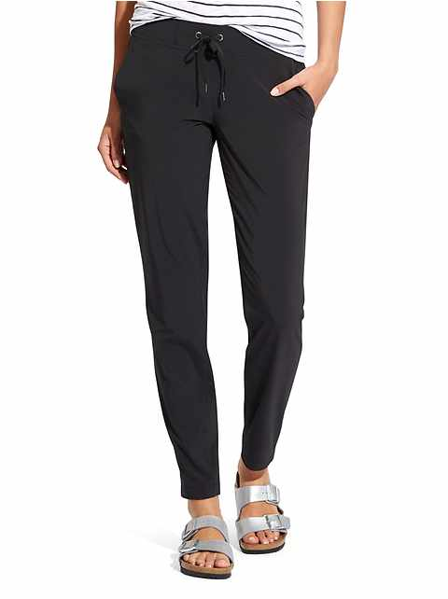
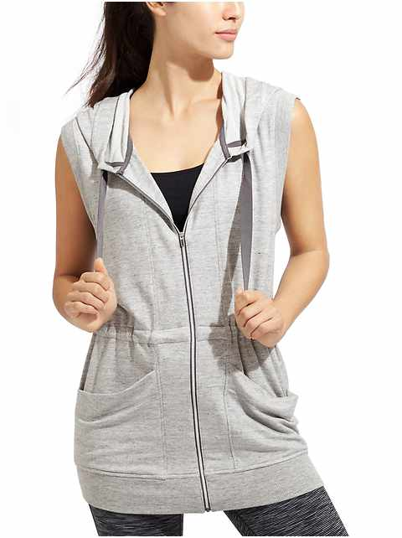
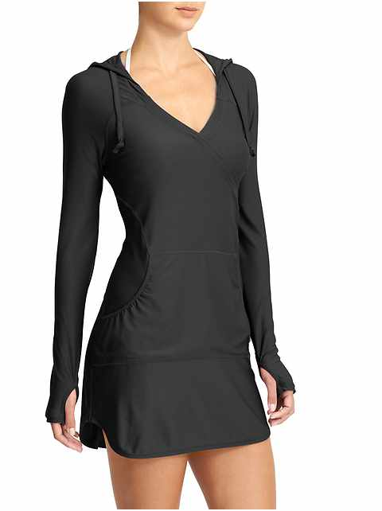
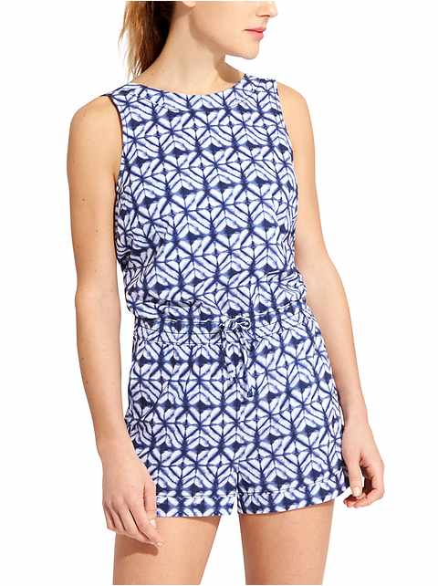
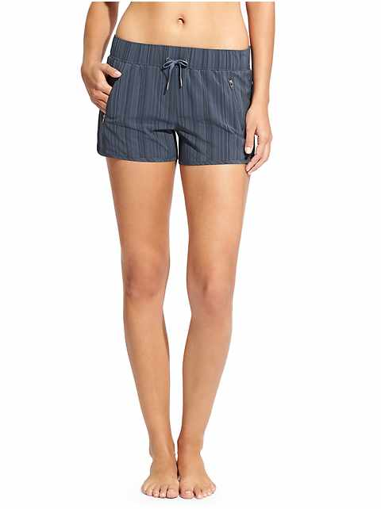
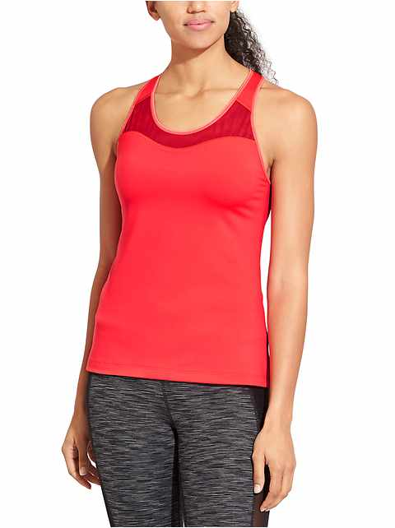
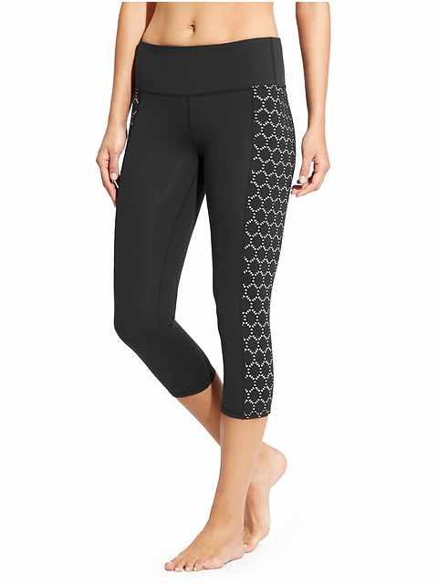
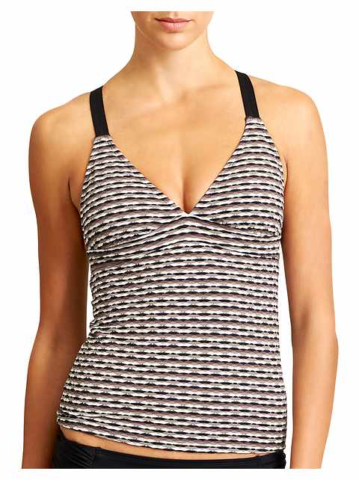
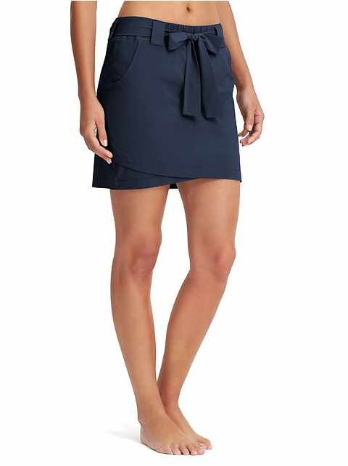
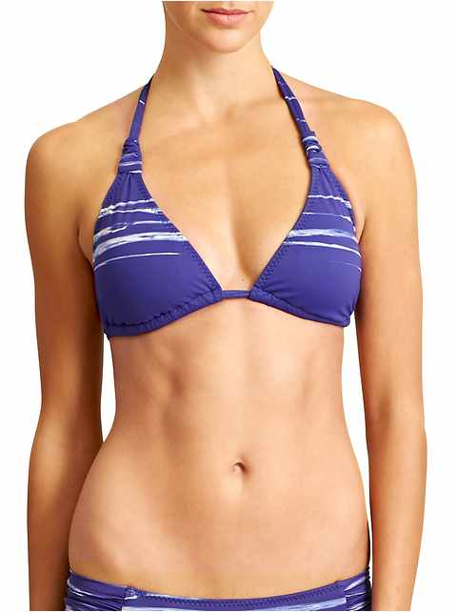
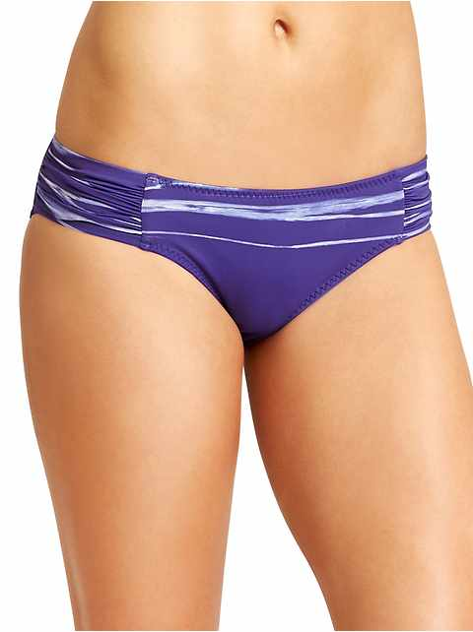
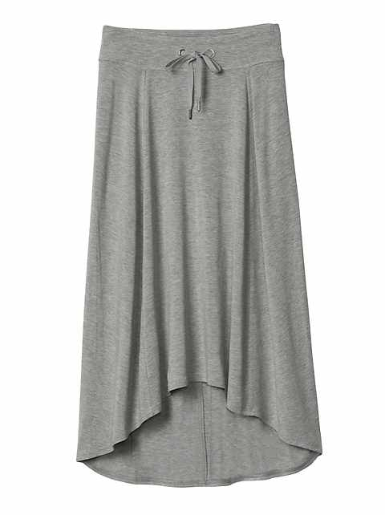
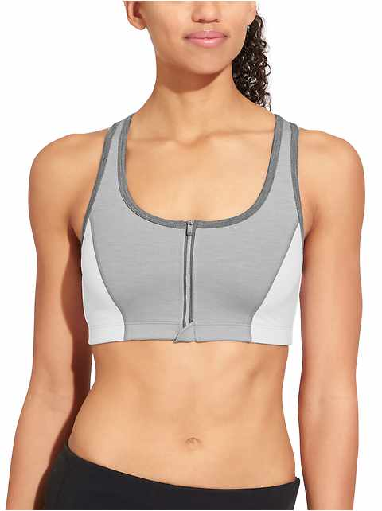
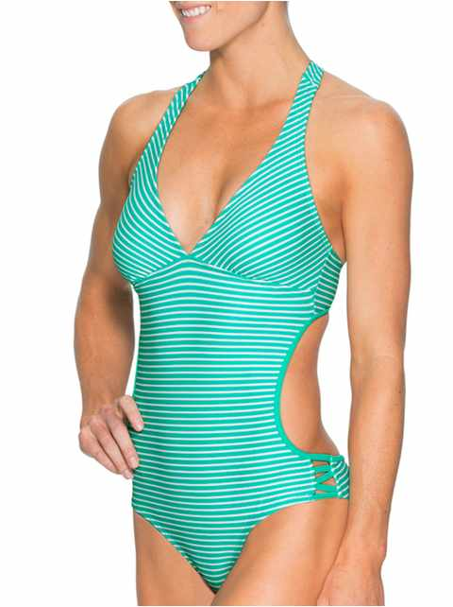
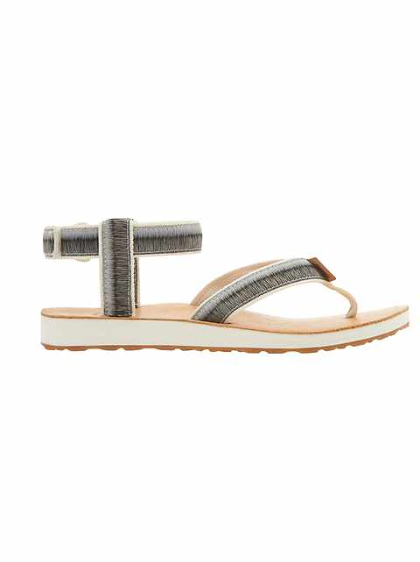

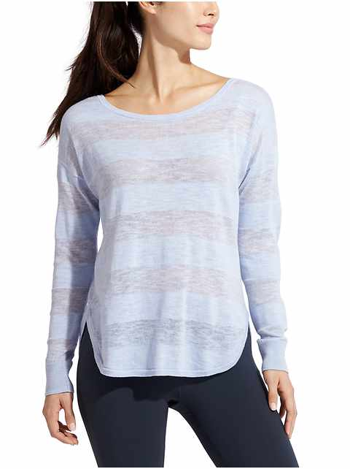
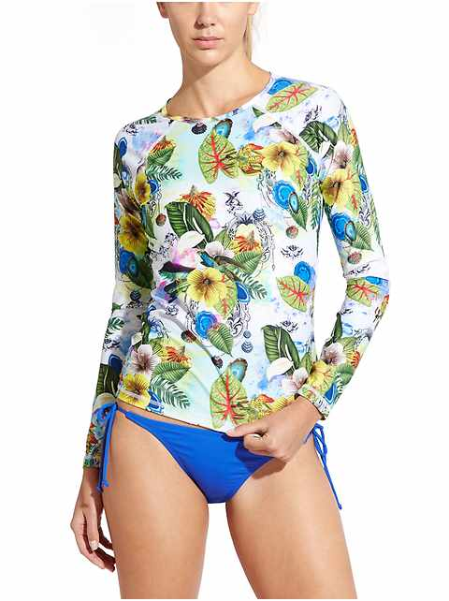

Categories Identified
WOMENS PANTS
WOMENS OUTERWEAR
WOMENS TOPS
WOMENS DRESSES
WOMENS SHORTS
WOMENS SUPPORT TOPS
WOMENS CAPRIS
WOMENS SWIM TANKINI
WOMENS SKORTS
WOMENS BIKNI
WOMENS SWIM BOTTOM
WOMENS SKIRTS
WOMENS BRAS
WOMENS SWIM ONE PIECE
WOMENS FOOTWEAR
WOMENS ACCESSORY
WOMENS SWEATERS
WOMENS SWIM RASHGUARDS
WOMENS INTIMATES

